Slide 1

Lessons from Migrating Oracle Databases to Amazon Aurora PostgreSQL
Notes:
Before we start presentation, let’s discuss some of house keeping items.
Hello Everyone!
Warn welcome to today's session – “Lessons from Migrating Oracle Databases to Amazon RDS or Amazon Aurora
”
My name is Shailesh Rangani, Cloud database engineer here at Datavail.

Slide 2

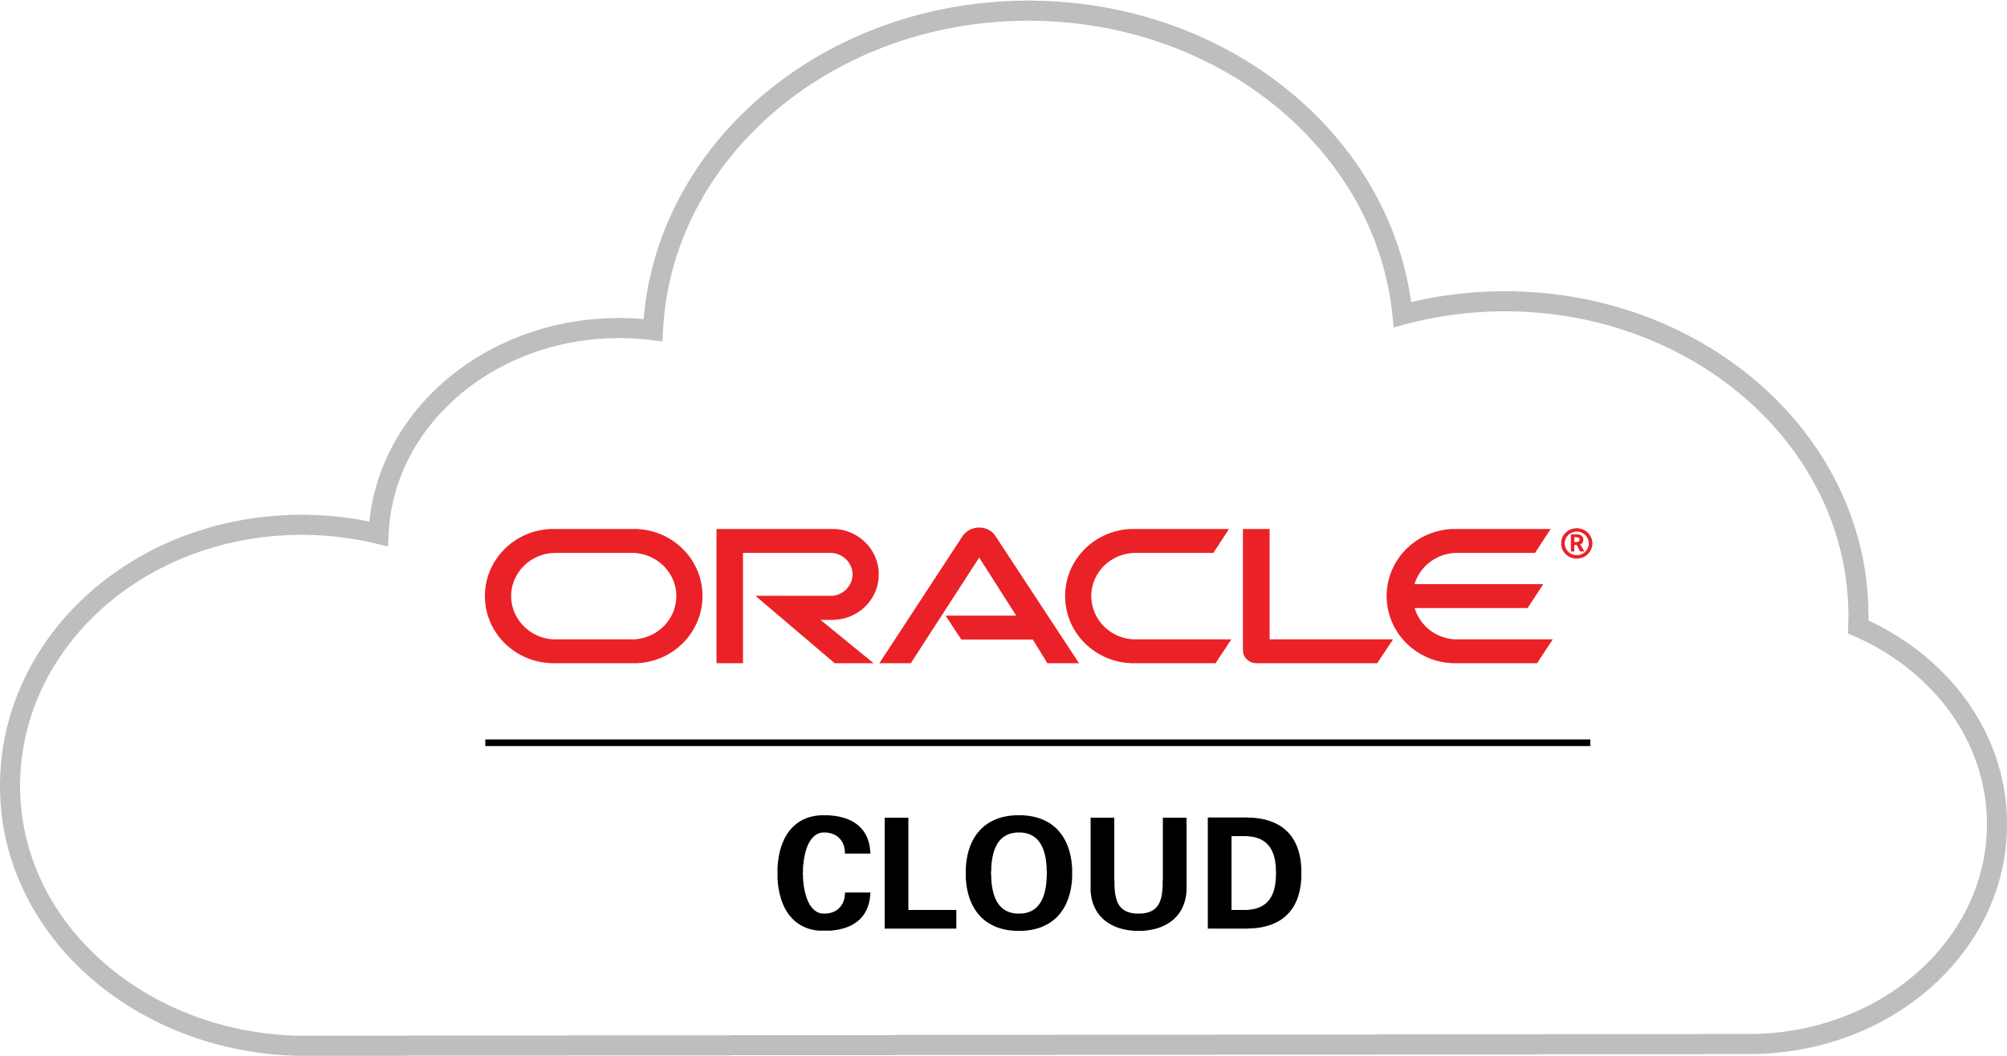

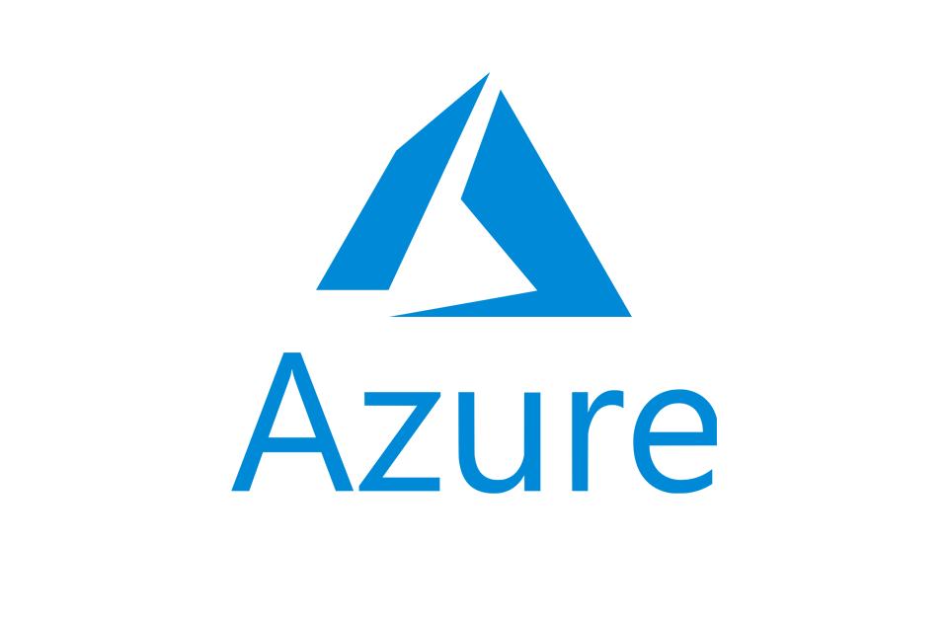
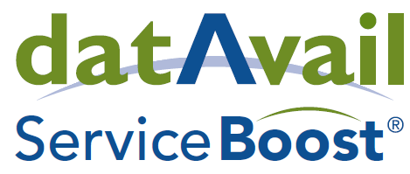
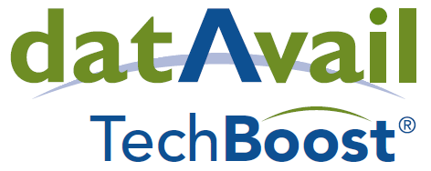






16
$25
+
M
Datavail at a Glance
Years
Invested
building and operating mission critical data and application systems
in IP that improves the service experience and drives efficiency
Delivering a superior approach to leveraging data through the application of a tech-enabled global delivery model & deep specialization in databases, data management, and application services.
1,000
+
Employees
staffed 24x7, resolving over 2,000,000 incidents per year
2022
www.datavail.com
2

Slide 3

Agenda
Why break free? The business case for moving to AWS databases
Common migration paths to modernization
Introduction to Amazon Aurora
Database migration
Best practices
Notes:
In today's agenda,
we will discuss how you can break free from commercial databases without sacrificing high availability, scalability, performance and rich database features.
We will also discuss what are common migration paths for migrating to the Cloud.
Then we will walk through Overview of Amazon Aurora architecture.
We will Deep dive in database migration options like SCT(Schema conversion tool) and DMS (Database migration services). You will keep getting these 2 words throughout this presentation and our LAB.
We will also see how these tools/services can be used for migrating commercial database engines to open sources database.
and best practices around it.
at the end we will have LAB on migrating Oracle database to Aurora PostgreSQL.

Slide 4
Flexible Ways to Break Free
Notes:
In Flexible ways to break free

Slide 5

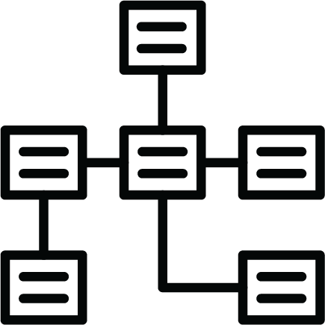
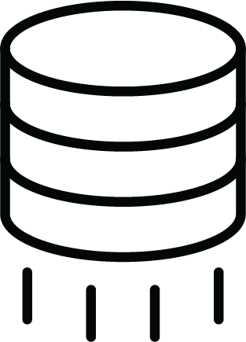
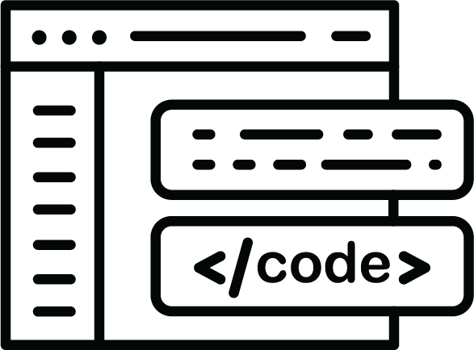
A Typical Database Migration Lifecycle
Analysis
Schema objects
Data migration
Testing
Cutover
Application code
Notes:
Let's look at typical database migration life cycle.
I often get question from customers.
Why some the migrations are quicker, and some takes too long?
Let’s try to get answer of that question from this diagram.
We can divide this diagram in 3 parts.
Analysis (which is your planning phase)
Testing (which is your Migration Phase)
AND
Cutover (where you point your applications from source to target)
Analysis and Cutover phases are very straightforward and well defined.
migration process (which is testing phase in this diagram) is the phase where we spent most of the time.
Time duration spent on this phase is depends on how much proprietary code like Procedure/trigger is written insight the database.
If you have a large monolithic database, you can also divide large database into smaller independent/isolated portion (like application vise, schema vise or tables vise) and prioritized them to move to Aurora PostgreSQL based on complexity and priority. By doing this, you don’t need to wait for everything to get converted and migrated before you can start using Aurora PostgreSQL.

Slide 6

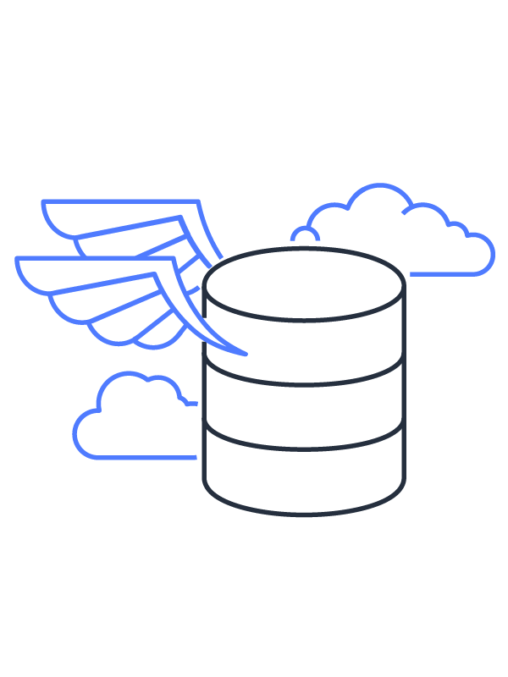
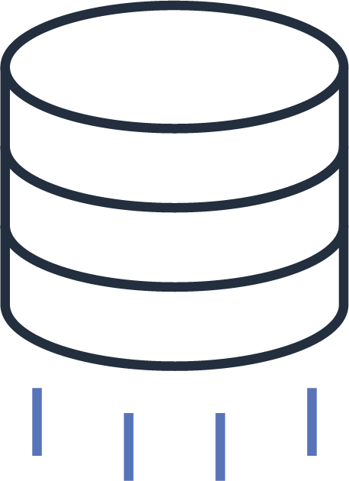
We Offer Flexible Ways to Help You Migrate
AWS Migration Tools
AWS ProServe and Migration Partners
AWS Database Freedom Program
Notes:
After analysis phase is completed, and now you have clear picture on what schemas and databases you want to migrate to Aurora PostgreSQL, then there are 3 options for you to move forward.
Option 1:
AWS migration tools like SCT and DMS
SCT and DMS are well proven tools and works as good starting point.
Option 2:
AWS profession services and Migration partner like Datavail
If you don’t have expertise or resources, that is where you can leverage migration partners like DatAvail’s assistance. Datavail has carried out many such migrations over last few years and has deep expertise on this domain.
3rd Option:
AWS database freedom program
This type of migration is the best for customers looking to move away from the licensing costs of commercial database and vendor lock-in. Most of these migrations have been from Oracle and SQL Server to AWS open source databases like PostgreSQL, MySQL.
However, There are use cases for migrating Oracle and SQL servers to NoSQL databases as well.

Slide 7
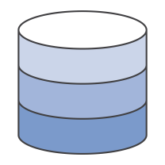
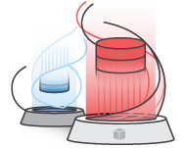
Flexible, Powerful Migration Tooling Most sources and targets, higher conversion automation
Step 1: Convert or copy your schema
Copy or convert
schema
Source DB or DW
AWS SCT
Destination DB or DW
Step 2: Move your data
Data
Source DB or DW
AWS DMS
Destination DB or DW
Notes:
Out of these 3 migration options we looked in previous slide, today we will focus mainly on self service migration phase using SCT and DMS.
Normally this migrations occurs in 2 steps.
Step 1: Convert or copy your schema
Schema conversion tool assess source database structure and migrates all of the objects including procedure/function to target database compatibility. SCT also has capability to scan embedded SQL from the application code and it can generate nice report with the recommendations.
Step 2: Move your data
Once metadata and database structure is migrated, next step is you want move your data to Aurora PostgreSQL and have it continuously in-sync with the source (which is Oracle). That is where DMS comes in picture.
If you are performing homogenous migration from on-prem to AWS cloud
like
PostgreSQL to Aurora/RDS PostgreSQL,
Oracle to Oracle RDS.
Mainly you will be using DMS since you may not need SCT for schema conversion.

Slide 8



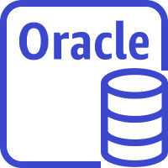


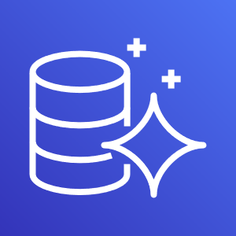

Case Study 1 – Midsized Service Firm
Challenges
Accelerated Migration
Outcome
Single monolithic DB
Lot of historical data
Oracle licensing cost
Encryption (TDE)
Scalability
Credential rotation
Quick testing environment
Native utilities for static data migration
AWS Database Migration Service (DMS) & AWS Schema Conversion Tool
Databases running Aurora PostgreSQL
Encryption via KMS
Auto Scaling (CPU based)
Native partitions
Database clone for quick test environment
Accelerated Amazon Aurora Migration
Oracle instance
AWS Database Migration Service
AWS Schema Conversion Tool
Aurora PostgreSQL
Notes:
Let’s go through couple of case studies where Datavail has comprehensively used SCT and DMS for migrating the Oracle database to the Aurora PostgreSQL.
These 2 case studies will give you clear picture on how Datavail has used these tools along with other AWS echo system to mitigate some of the customer challenges.
in this use case : , we migrated single monolithic database from Oracle to Aurora PostgreSQL.
There were various challenges on source side, That is where we advised customer to take advance of Aurora PostgreSQL and AWS integrated services with Aurora.
Some of key challenges were:
High licensing cost,
Need of data encryption and cost (Oracle TDE)
Salability,
SOX requirement for database credential rotations, and
Immediate testing environment setup for replicating production like data and production issues.
Some of the tasks like refreshing test environment from production database, database credential rotation were very time consuming and tedious.
So what we did…
we used SCT & DMS to migrate the Oracle to the Aurora PostgreSQL. Historical data were migrated using manual methods (exporting data in CSV and using PostgreSQL COPY command) to speed up migration.
As outcome we had database migrated to Aurora PostgresQL. We used other AWS echo system to remediate some of challenges we had on on-prem like
Encryption : we used KMS to encrypt data at rest.
We used CPU based Auto Scaling to achieve read scalability in event of workload spike.
Since there were lot of historical data, we moved them to PostgreSQL native RANGE partitions
Aurora database clone : you can quickly and cost-effectively create clones of all of the databases within an Aurora DB cluster. The clone databases require only minimal additional space when first created.
Clone environment gets ready in few minutes compare to hours in on-prem case.

Slide 9
Case Study 2 – Midsized Financial Company
Challenges
Accelerated Migration
Outcome
Oracle licensing cost
Multiple Sources
Heavy read intensive workload over weekend
150,000 lines of code to convert
3,000 + objects to convert
AWS Database Migration Service (DMS) & AWS Schema Conversion Tool
Expert PostgreSQL developers/AWS SA
Code conversion 2 months
Regressing Testing
Databases running Aurora PostgreSQL
Faster reports
Lower licensing costs
IAM authentication at DB level
DB code moved to app layer
Auto Scaling (schedule based)
Accelerated Amazon Aurora Migration
Oracle instance
AWS Database Migration Service
AWS Schema Conversion Tool
Aurora PostgreSQL
Notes:
This is 2nd case study where we migrated midsize financial company’s Oracle database to the Aurora PostgreSQL.
In this case, data were on various Oracle databases , this was modernization + consolidation project.
One of challenge this customer had was “heavy read intensive workload over weekend”
As part of analysis, we found that source databases contains lot of proprietary code.
Again, we used DMS/SCT effectively to convert schema and data. We had to engage Datavail’s export development team for analyzing and migrating database code from Oracle to PostgreSQL. Some of code was moved to app layer.
So as outcome:
we had Database migrated to single Aurora PostgreSQL.
No more cost for Oracle licenses. No more lock in period.
Faster reports
IAM authentication at DB level
Some of DB code was moved to app layer including serverless Lambda functions.
We setup “scheduled base” auto scaling where each Friday 5 PM Auto scaling adds 2 read nodes, so it has enough capacity to serve weekend workload and remove these nodes by Sunday 10 PM PT automatically.
Please free to reach out to us at datAvail.com if you are interested in learning more about these case studies and any other migration related questions.

Slide 10
Introduction to Amazon Aurora
Notes:
Again as reminder, if you have any questions, please feel free to use chat options in GotoWebinar.
Before we get into schema conversion and migration path, Let’s look at what is Amazon Aurora and its architecture.

Slide 11
Benefits of Amazon Aurora
Amazon Aurora - enterprise database at open-source price, delivered as a managed service.
Speed and availability of high-end commercial databases
Simplicity and cost-effectiveness of open-source databases
Drop-in compatibility with MySQL and PostgreSQL
Amazon Aurora
Simple pay as you go pricing
Notes:
Amazon Aurora is a MySQL and PostgreSQL-compatible relational database built for the cloud. It is delivered as the managed service.
Aurora combines the performance and availability of traditional enterprise databases with the simplicity and cost-effectiveness of open source databases.
It is drop-in MySQL and PostgreSQL compatible.
Pricing mode is very simple (pay as you go) and no “lock in period” like commercial databases.

Slide 12
Scale-out, Distributed, Multi-tenant Storage Architecture
Cluster Endpoint
Reader Endpoint
Purpose-built log-structured distributed storage
Storage volume is striped across hundreds of storage nodes
Storage nodes with locally attached SSDs
Continuous backup to Amazon S3
Writer
Reader
Reader
SQL
SQL
SQL
Transactions
Transactions
Transactions
Caching
Caching
Caching
SHARED CLUSTER STORAGE VOLUME
AZ 1
AZ 2
AZ 3
Amazon S3
Notes:
Amazon Aurora’s key feature is distributed, fault-tolerant, self-healing storage sub system. This storage system span across 3 Availability Zones (AZs). Each Availability zone will have 2 copies of data.
Amazon Aurora delivers high performance and availability with up to 15 low-latency read replicas.
Aurora performs continuous backup to Amazon S3.
Storage nodes also replicates across three Availability Zones (AZs) as shown in this slide.
Storage can auto-scales up to 128TB per database instance.
By default Aurora provides one cluster end point and one reader end point.
Cluster endpoint points to the writer node.
While the reader end point points to all available reader nodes and serves traffic in round robin fashion. You can have up to 15 read replicas.
Aurora also provides option for creating custom end point which you can point to specific instance or set of instances.

Slide 13
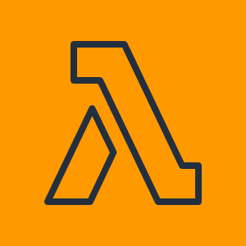




Leverages the AWS Cloud Ecosystem
AWS Lambda
Amazon S3
AWS IAM
Invoke AWS Lambda events from stored procedures/triggers
Load from, save to Amazon S3, store snapshots and backups in S3
Use AWS Identity & Access Management (IAM) roles to manage database access control
Amazon CloudWatch
Amazon Sagemaker Amazon Comprehend
Upload systems metrics and audit logs to Amazon CloudWatch
Make inferences directly from your database using SQL calls
Notes:
Aurora is also tightly integrated with other AWS echo system so you can leverage capability of other AWS services with Aurora.
Like.
AWS Lambda: you can invoke lambda events from your database code like procedure/function
AWS S3: You can directly copy your data to and from S3 bucket. Aurora performs continues backup and snapshots to S3.
Using AWS IAM you can authenticate against Aurora PostgreSQL database without using database credential.
You can publish your Aurora logs to AWS cloudwatch and perform real time analysis on logs. You can also use Cloudwatch to create alarms
Aurora is also integrated with machine learning (ML) services using simple SQL queries.
This simplifies developing database applications which uses Amazon Sagemaker and Amazon Comprehend to perform any predictions.

Slide 14
Automates Administrative Tasks
Schema design
Query construction
Query optimization
Automatic fail-over
Backup & recovery
Isolation & security
Industry compliance
Push-button scaling
Automated patching
Advanced monitoring
Routine maintenance
YOU
AWS
Takes care of your time-consuming database management tasks, freeing you to focus on your applications and business
Notes:
As Aurora is the managed services, lot of tasks like hardware provisioning, installation, patching, backup, failover, monitoring are taken care by AWS.
Because of these now you have time focus on application improvement tasks are like schema design, query optimizations.

Slide 15
Who is Adopting Amazon Aurora?
Customers migrating from open-source PostgreSQL
Customers using
commercial DB engines
Customers building new applications
Higher performance
Better availability and durability
Easy migration; no application change
One-tenth of the cost; no licenses
Comparable performance and availability
Migration tooling and services
Integration with other AWS services
Cloud-native capabilities and access mechanisms
Scalability, availability, managed service
Notes:
Let’s see who all in today’s work are adopting to Amazon Aurora. I would divide them in to 3 key catagories:
If you already have PostgreSQL running in on-prem, in such cases, without any application changes you can migrate them to Aurora PostgreSQL
If you are using commercial engines, in that case with 1/10 of the cost you can migrate to Aurora PostgreSQL (You will use tools like SCT and DMS for such cases)
If you are building new application, you can take advantages of Scalability, availability and managed service. And you can choose amazon Aurora as your backend.

Slide 16
Schema Conversion
Notes:
Now look at database migration option:
Frist we will look into schema conversion tool and then we will look in to database migration services.

Slide 17
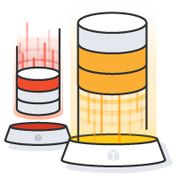
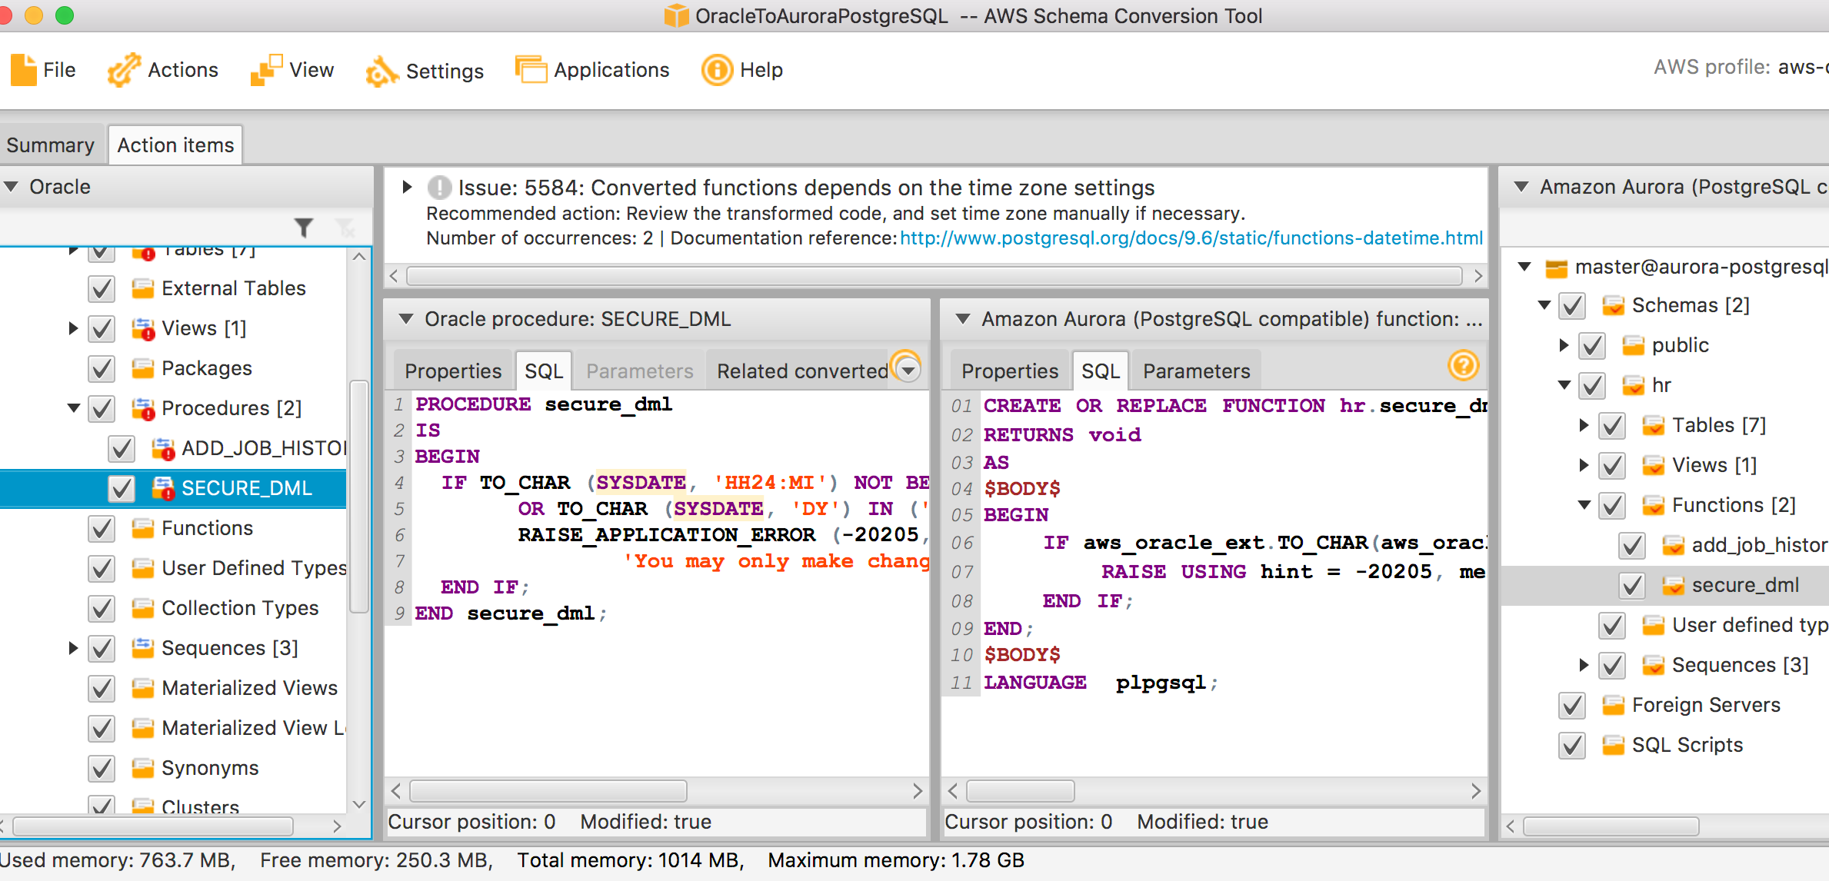
AWS Schema Conversion Tool
Tab with the assessment report
Manual conversion tips
Assessment report
Project interface
Code browser
Automates many conversion tasks
Schemas
Functions
Views
Packages
Indexes
Side by side code view
Stored procedures
Triggers
Synonyms
User defined types
Tables
Sequences
Notes:
SCT is desktop application, It is free and you can download on your laptop, desktop or you can install on an EC2 instance.
This is interface for SCT.
In extreme right and left you can object browser
In middle you have code browser.
Code browser gives you side by side view of code for comparison. How is your code before migration and how is code after migration.
In case if SCT cannot convert function/stored procedures, it will give you manual conversion tips as shown in this slide.

Slide 18
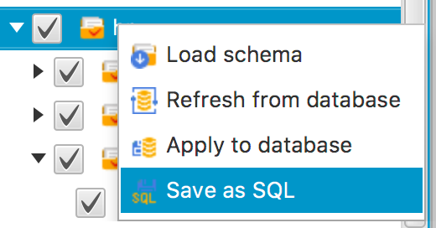
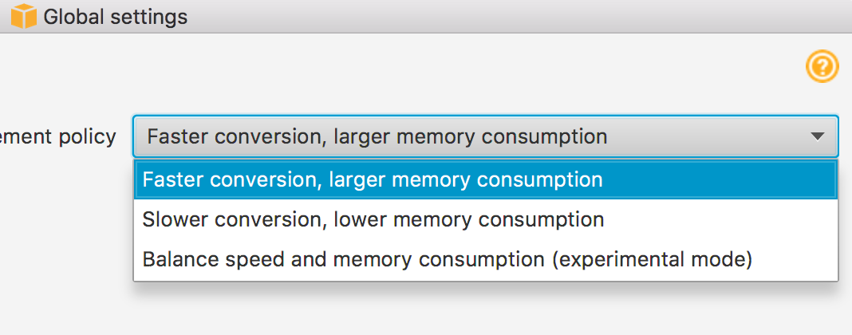
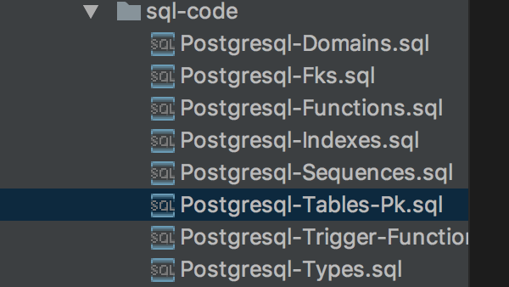
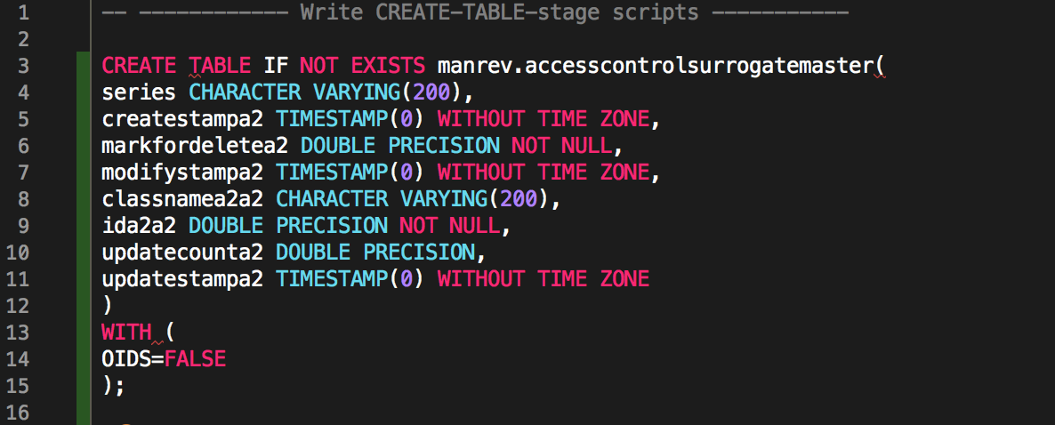
AWS Schema Conversion Tool Tips
Save as an SQL file
Allows you to apply only Table DDL & PK
Save the secondary DDL for after migration
Memory management
Global settings
JVM settings
Notes:
====NEXT====
Once you have converted your schema and it’s objects from Oracle to PostgreSQL, Before you apply these SQL to PostgreSQL, you can save those objects are file.
What SCT does is, it saves
One portion of file is tables and primary key
One portion of file is reference key, secondary indexes and constraints
One portion of file if functions/procedure and so on.
Using this you can create your target environment with tables and Primary key ONLY. After this you can perform full load using DMS, once full load is completed, you can apply all other database structure.
=== NEXT ===
While migrating or converting your schema using SCT, you should keep eye on memory consumption of your local desk or laptop.
You can also change memory configuration metrics at 2 different places
SCT settings
You can trade the speed of conversion with memory consumption
JVM settings which is in SCT configuration file

Slide 19
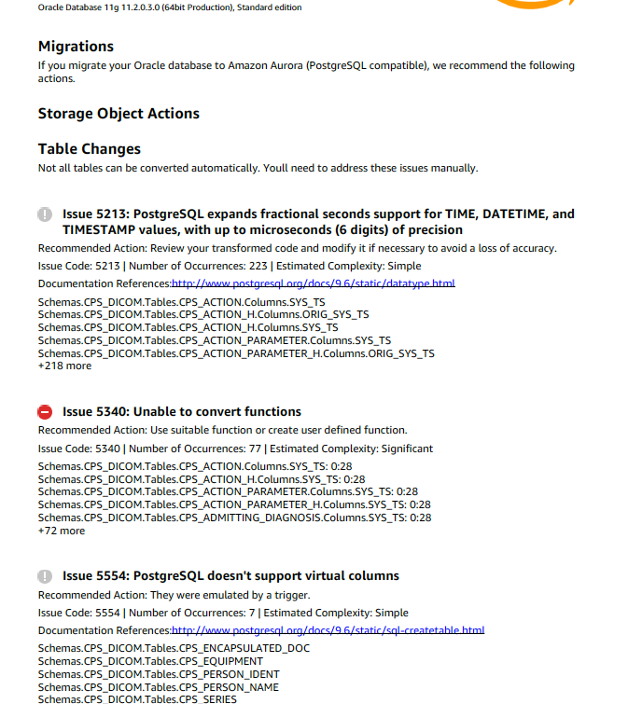
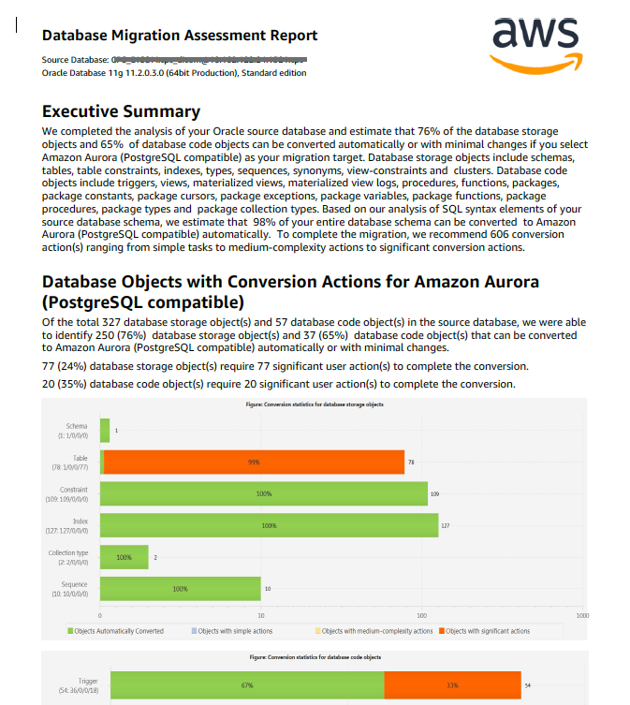
SCT Migration Assessment Report
Connect SCT to “source” & “target”
Run “assessment report”
Read “executive summary” & follow detailed instructions
More: https://docs.aws.amazon.com/SchemaConversionTool/latest/userguide/CHAP_AssessmentReport.Create.html
Notes:
I believe as database person, you often would have got question:
I have this Oracle database and can you tell me how long it will take to migrate this to Aurora PostgreSQL.
Can you tell me how complex it could be?
How many days?
Can it be done?
Often you are force to guess, with SCT you can perform calculated estimation with supporting data.
All you need to perform is…
Download and install SCT
Conenct to Source and target database type
And
Run assessment report.
First part of SCT report is Conversion action:
In this section SCT is going to show you how many objects are there in database,
how many of them will get converted automatically and
how many needs manual conversion.
Objects which required manual conversion: We will classify them into 3 different category
Simple (< 1hour)
Medium or complex actions (< 4 hours)
Significant actions (> 4 hours)
Second part of SCT report is detailed section :
Whichever object SCT is unable to convert, it is going to give your recommended action.

Slide 20
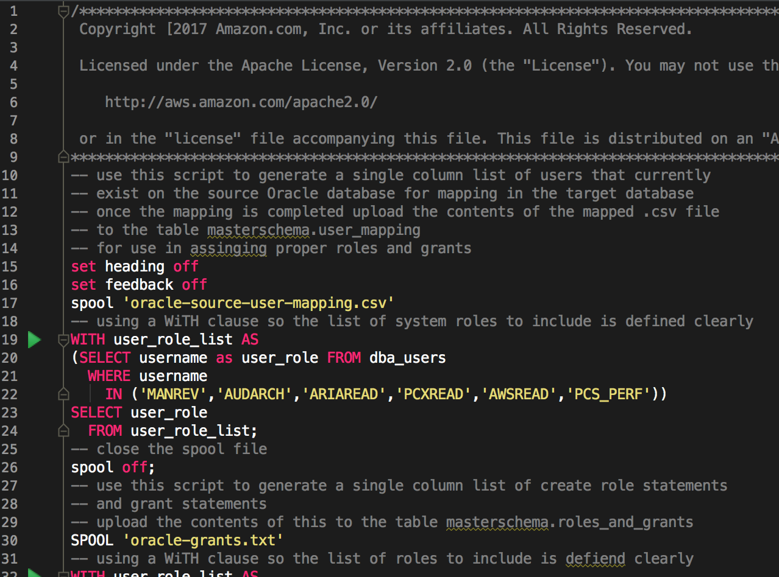
SQL Scripts
SCT does a great job of converting your schema and code objects
Users, roles, grants
Functions
Schemas
Indexes
Views
Packages
Stored procedures
Synonyms
Triggers
User defined types
Tables
Sequences
https://aws.amazon.com/blogs/database/use-sql-to-map-users-roles-and-grants-from-oracle-to-postgresql/
Notes:
SCT will help in converting storage objects and code objects but it cannot convert users, roles and grants.
So you will have to write manual scripts to migrate them from Oracle to PostgreSQL.
There are various nice AWS blogs which can help in you in how to move users, roles and grants from Oracle to PostgreSQL. These AWS blogs also has some sample code which you can re-use in your project.

Slide 21
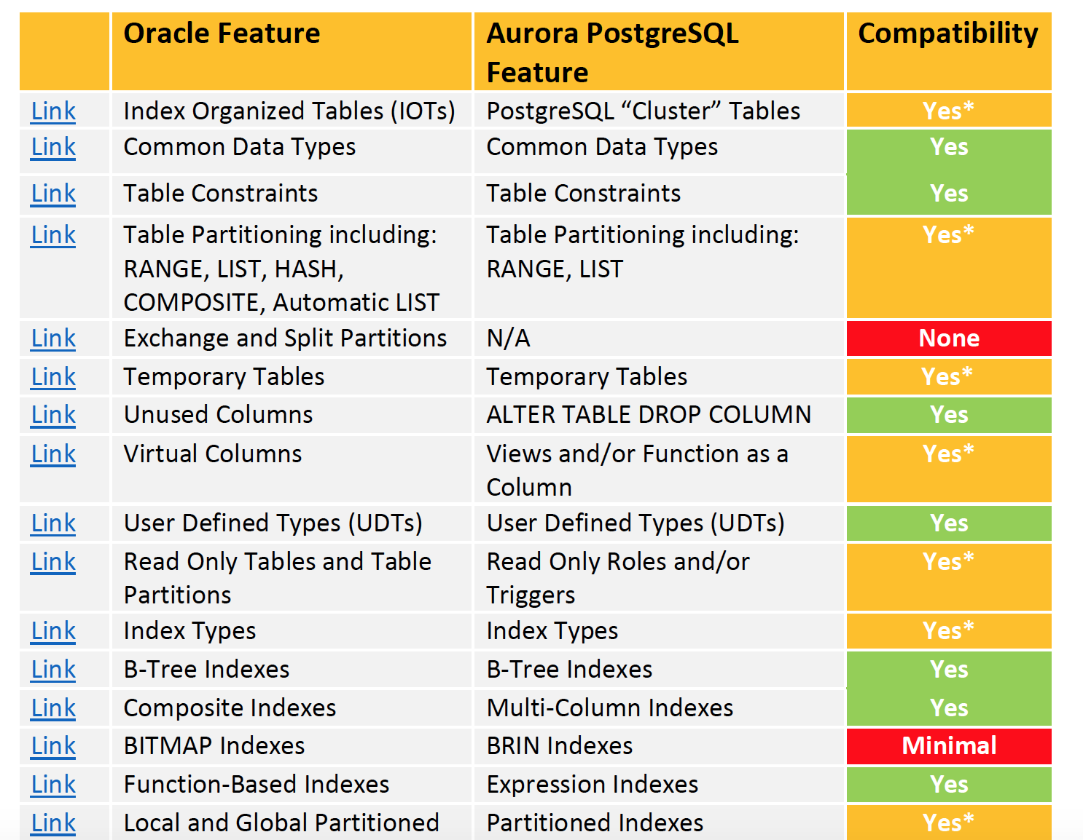
Oracle to Amazon Aurora PostgreSQL Migration playbook – example
More: https://d1.awsstatic.com/whitepapers/Migration/oracle-database-amazon-aurora-postgresql-migration-playbook.pdf
Notes:
Schema conversion process has 2 parts.
Automatically converted objects
Failed objects with recommendation
For this recommendation, there is migration playbook which covers all scenarios, samples and example.
This paybook gives side by side feature and really handy as good reference point.
For example, if you have Index organized tables in Oracle, you can use Cluster tables in PostgreSQL.
If you are using function based indexes in Oracle you can replace that functionality with Expression indexes and this can be easily convertible with minimal efforts

Slide 22
Data Migration

Slide 23



Move Data Using Data Migration Service
Read
Write
Oracle Databases
AWS Database
Migration Service
Amazon Aurora
AWS DMS Replication Instances
AWS DMS Replication Tasks
Notes:
Once you convert schema from source database to target database, next step is actual data.
You will be using Database migration services for migrating data from source to Target.
DMS reads data from source which is Oracle database in our case and writer to target database which is Aurora PostgreSQL.
To migreate data, DMS uses replication instances and replication task.

Slide 24
Support for the Following Conversions
Source* Database | Target* Database on AWS
Oracle database | Amazon Aurora, MySQL, PostgreSQL, Oracle
Oracle data warehouse | Amazon Redshift
Azure SQL | Amazon Aurora, MySQL, PostgreSQL
Microsoft SQL Server | Amazon Aurora, Amazon Redshift, MySQL PostgreSQL
Teradata | Amazon Redshift
IBM Netezza | Amazon Redshift
Greenplum | Amazon Redshift
HPE Vertica | Amazon Redshift
MySQL and Maria DB | PostgreSQL
PostgreSQL | Amazon Aurora, MySQL
Amazon Aurora | PostgreSQL
IBM DB2 LUW | Amazon Aurora, MySQL, PostgreSQL
Apache Cassandra | Amazon DynamoDB
Source: https://docs.aws.amazon.com/dms/latest/userguide/CHAP_Source.html Target: https://docs.aws.amazon.com/dms/latest/userguide/CHAP_Target.html
Notes:
DMS can use many of the most popular databases as a source and target for data replication. The target can be on an Amazon Elastic Compute Cloud (Amazon EC2) instance, an Amazon Relational Database Service (Amazon RDS) instance, or an on-premises database.

Slide 25

AWS Database Migration Service Working with DMS components
Replication Instance
C - compute R - memory T - burstable
Endpoint
Connect source / target from replication instance
Choose advanced override settings
Task
Full Load
Change Data Capture
Notes:
You can DMS instance into 3 components.
Replication instance
End points
Replication task
Task performs actual data migration job from source to target and it runs on replication instance.
There are 3 types of replication instances
C which is computer optimized category
R which is memory optimized category
T which is burstable instance type category

Slide 26
AWS Database Migration Service Components of a DMS task
Choosing a “migration type”
Full Load
Change Data Capture (CDC)
Choosing a target table prep mode
DMS can create tables, however, better pre-create table with SCT
Flexibility to drop or truncate tables
Include LOB columns in replication
Why limited LOB (Large Object) mode is a better choice?
Selection & transformation rules, logging, exceptions, and others
Flexible in selection but limited transformations
How to work around transformations
Notes:
There are 4 key components of DMS tasks.
Migration type
Target table prep mode
How you want to handle LOB
Selection, transformation rules, logging and others
For each these DMS components, let’s walk though in details in next 4 slides.

Slide 27
Task – Migration Type
Choose migration type
Existing data
Creates files or tables in the target database
Populates the tables with data from the source
Migrate existing data option in the AWS console and Full Load in the API
Captures changes on the source during migration
Once initial migration completes, changes are applied to the target as units of completed transactions Migrate existing data and replicate ongoing changes option in the AWS console and full-load-and-cdc in the API.
Existing data and replicate changes
Replicate changes only
Reads the recovery file on the source database
Groups together transactions and applies them to the target. Buffering as needed
Replicate data changes only option in the AWS console
Notes:
Migration type helps DMS on what to do during migration process.
There are 3 options for this.
Existing data: it means full load. Bring everything
Existing data and replication changes: first it will do full load and then it will do changes which occurred after full load.
Replicate changes only: in this case, Reads the recovery file on the source database Groups together transactions and applies them to the target.

Slide 28
Task – Target Preparation
Target preparation
Do nothing
In Do nothing mode, AWS DMS assumes target tables are pre-created. In full load or full load plus CDC, ensure that the target tables are empty before starting the migration.
Drop tables on target
In Drop tables on target mode, AWS DMS drops the target tables and recreates them before starting the migration. This ensures that the target tables are empty when the migration starts.
Truncate
In Truncate mode, AWS DMS truncates all target tables before the migration starts.
Notes:
Target preparation mode tell DMS on what to do before loading data.
Do nothing: that means DMS assumes that tables are already existing (This will be good option for Heterogeneous)
Drop tables on target: in this case DMS will drop tables in target before loading data (This may be good options for homogeneous i.e. PostgreSQL to PostgreSQ)
Truncate : in this case DMS will truncate target table before loading data.

Slide 29
Task – Include LOBs
Include LOBs
Don't include LOBs
LOB columns are excluded from the migration.
Full LOB mode
Migrate complete LOBs regardless of size. AWS DMS migrates LOBs piecewise in chunks controlled by the Max LOB size parameter. This mode is slower than using Limited LOB mode.
Limited LOB mode*
Truncate LOBs to the value of the Max LOB size parameter. This mode is faster than using Full LOB mode.
Notes:
There are 3 options for LOB in tasks:
don’t include LOB. If you decided to move your LOB to S3 in that case you can choose this option.
Full LOB mode : DMS will migrate LOB regardless of size of LOB. This mode is usually slower than limited LOB
Limited LOB mode : DMS will pre-allocate memory of size specified and load LOB data in bulk. This mode is faster than using Full LOB mode

Slide 30
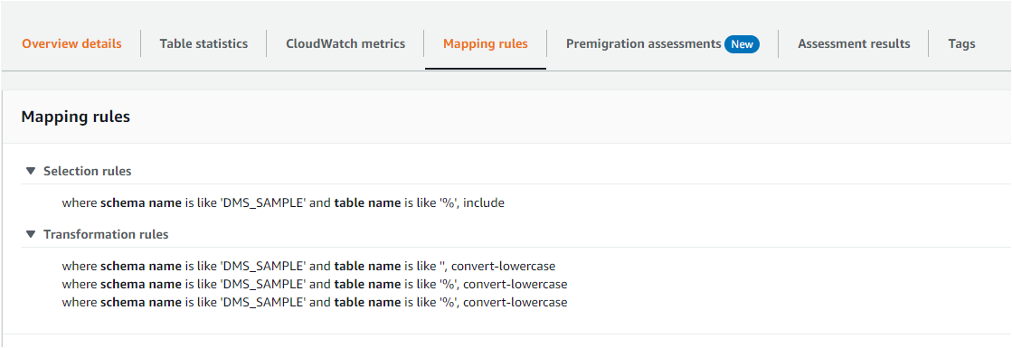
Task – Selection and Transformation Rules
Notes:
This is section where you defined your transformation rules, how many tables you want to load in parallel (DMS loads 8 tables at time with commit rate 10,000).
Since PostgreSQL’s metadata is in lower case, you will need to define transaction rule to convert scheme, table and columns to lower cases.

Slide 31





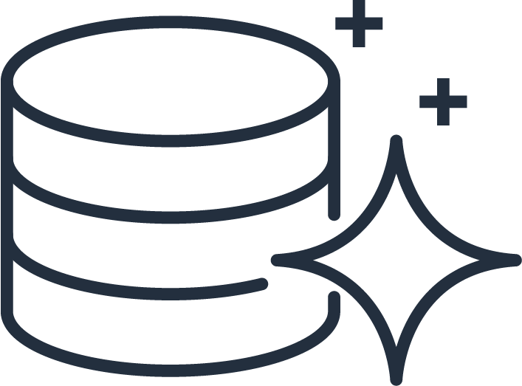
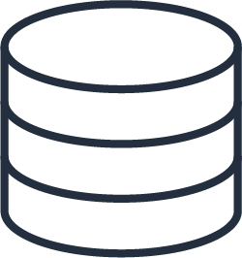
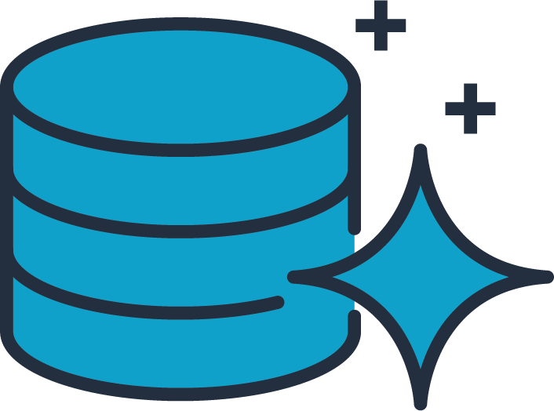

AWS Database Migration Service
AWS Cloud
Customer On-premises
VPC
Oracle
Aurora PostgreSQL
VPN
DMS Replication Instance
Start a replication instance
Connect the source and target endpoints
End Point Connection
Full Load
DMS FULL LOAD the data from Source to Target
Change Data Capture
DMS Change Data Capture to replicate ongoing changes
Application users
At steady state – take an outage, validate & redirect connection
Notes:
So in nutshell, this is how DMS migration service will work.

Slide 32
Best Practices for Production Rollout

Slide 33
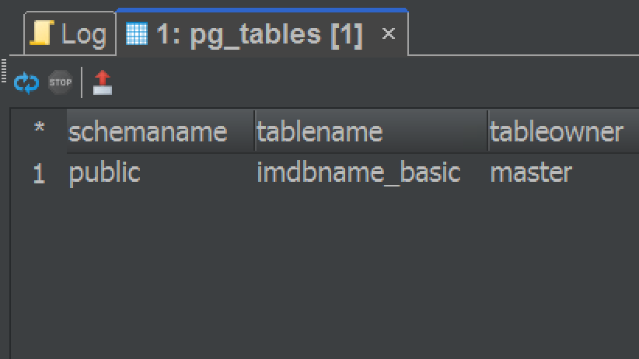
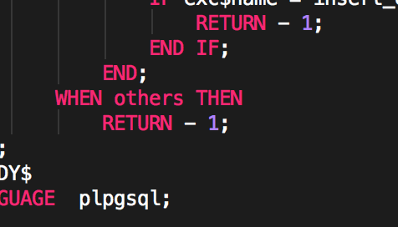
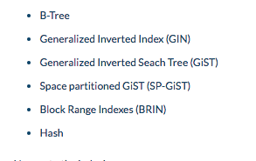
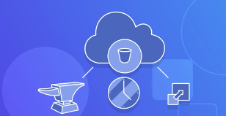
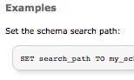
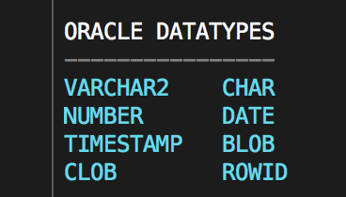
Understand Basic Database Engine Differences
PostgreSQL is a lowercase data dictionary
Use “exception handlers” when needed, not by default
PostgreSQL has six different index types.
Store your BLOBs in Amazon S3 instead of the database
search_path replaces PUBLIC SYNONYM
PostgreSQL has 64 datatypes
Notes:
Ideal behind this slide is to understand and appreciate differences between Oracle and PostgreSQL engine.
There are good things with PostgreSQL, it is known as developer’s database. It has rich 64 data types. It has more index types.
So design your workload to take advantages for these features.
PostgreSQL has lowercase data dictionary while Oracle is upper case.
PostgreSQL handles NULL differently than Oracle. In Oracle empty space is NULL while PostgreSQL doesn’t treat that in same way.
Oracle has public synonyms, you can use serach_path with minor modification to replace that feature.
Oracle has autonomous pragma transaction, you can achieve that in PostgreSQL using Dblink options.

Slide 34
Overview of Migration Steps

Slide 35

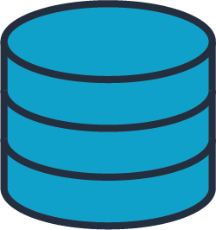

Start Full Load
Source
Replication Instance
Target
Notes:
EM

Slide 36

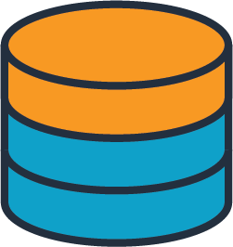

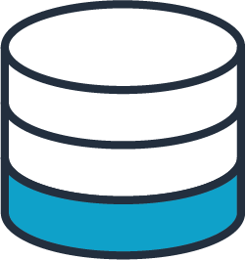

While Loading Data Also Capture Changes
App
Source
Replication Instance
Target
Notes:
EM

Slide 37
Load Complete – Apply Captured Changes
App
Source
Replication Instance
Target
Notes:
EM

Slide 38

Changes Reach Steady State
App
Source
Replication Instance
Target
Notes:
EM

Slide 39
Shutdown Apps and Apply Remaining Changes
App
Source
Replication Instance
Target
Notes:
EM

Slide 40
Change Your Application Endpoint
App
Source
Replication Instance
Target
Notes:
EM

Slide 41


Slide 42


Complete
Session Evaluation
For a Chance to WIN
Virtual Reality Headset w/Controller & Headphones

Slide 43


Thank You
Shailesh Rangani
Director & Global Practice Lead : PostgreSQL Services
shailesh.rangani@datavail.com
+1 866-623-4956

